Slide 1
Startup Analysis
Luke Mills, Howard Choi, Daniel Lowe

Slide 2
What Factors Influence Startup Success?
Originally focused on tech companies only
Broadened scope to include all startups; much more interesting analysis
Original Hypothesis: Location and industry should have a big influence on success rate.
Some fields naturally lend themselves to a higher success rate than others.
Competition might also be a big factor.

Slide 3
Defining Success and Failure
Measure of Success = amount of funding
Measure of Failure = company closure

Slide 4
Collecting Data
Crunchbase allowed us to export all data straight to Excel
Too much data for Excel and would crash Excel on its own.
Data was converted to csv format and parsed using Python.
From there, Python scripts handled computations
Stock market data retrieved from multpl.com

Slide 5
Removing Extraneous Data
Some data included was irrelevant
Data came from as early as the 19th century
IPOs
Null data
Notes:
A key part of our process was removing the extraneous data that crunchbase served us. We decided that we were only interested in companies formed after 1990, as this is the age in which the internet and technology in general started picking up, so we had to eliminate the data of companies that preceded that date. It was interesting, though, to see that Crunchbase had data on the founding of a Russian bank that started in the 1800s and was funded with the equivalent of $58 million in today’s money.
Beyond this, some of the data was not there for certain entries. This included things like categories, country of origin, and date of founding sometimes. Given that this was fundemental to our study, we eliminated the rows whose fields were null for each of the respective computations.

Slide 6
Processing the Data
Computations done in Python 3
Metrics of interest:
Avg. funding for companies in each country
Avg. funding for companies founded in various years
Avg. funding for companies in various categories of business
Rate of closure for companies in each country
Rate of closure for companies founded in various years
Rate of closure for companies in various categories of business
And more...
Data was written to CSVs
Notes:
So after I successfully removed the extraneous data, I had to perform the computations of the various metrics we were interested in. This included average funding and rate of closure for companies in various countries, for companies founded in different years since 1990, and for companies in each category of business.
When this was completed, the data was written to a CSV so that Daniel could the analysis of the data.

Slide 7
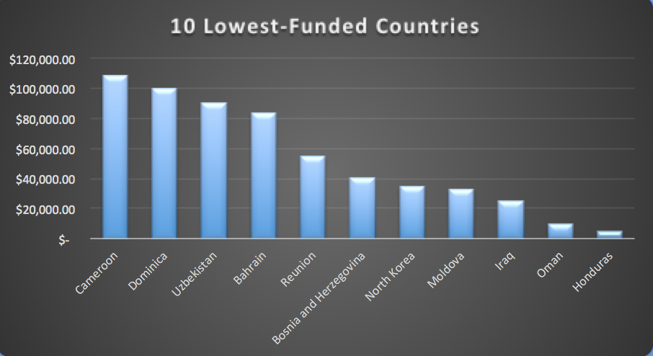
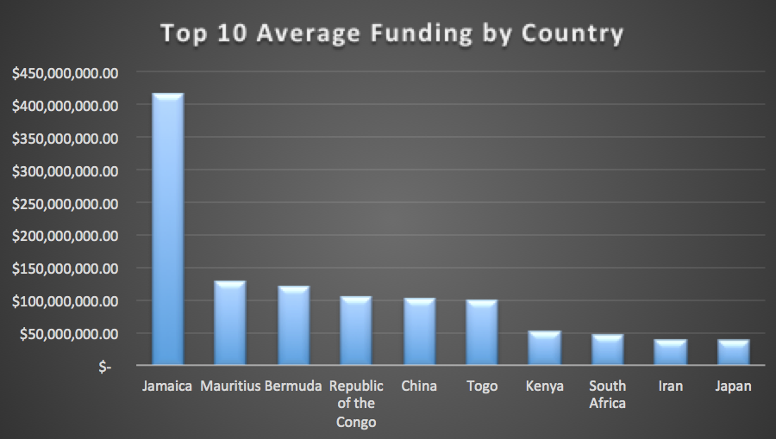
Funding by Country
Notes:
One of our key interests in this project was seeing if location had anything to do with success rate. To get a look at this, we first examined the highest and lowest funded startups across the world. (Jamaica is high b/c digicel received $1.2B in initial funding)
This information was inconclusive. Note how the US is nowhere to be found in the top 10. However, as expected, the lowest 10 were either countries we hadn’t really heard of, or ones we had heard of but would expect to be low such as North Korea.
It was interesting to see the average funding for Jamaica. There were only 13 startups there, and yet the funding was so high. In the future we’d definitely like to investigate what the industries of these
We can in some ways argue that funding makes a big difference on success if you throw enough money at it. Jamaica wasn’t even on the list of closures from 1990-present day, however, it also only had 3 startups.

Slide 8
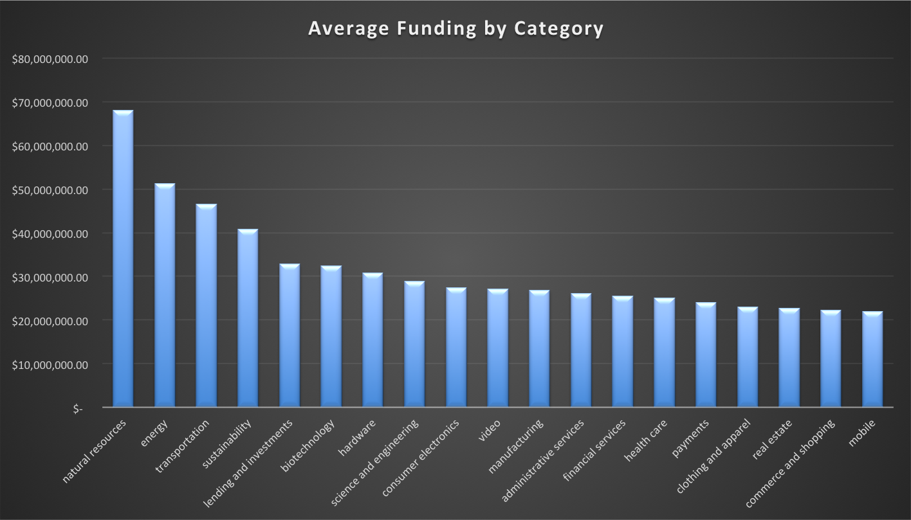
Funding by Category
Tech is not as high as expected.
This is likely due to it being less relevant to living everyday life.
Software industry is #30 on highest average funding list!
Natural resources - multiple companies with funding of magnitude 8+ figures
Notes:
When looking at average funding by category we expected the tech industry to be near the top considering that’s the first thing that comes to mind upon hearing the word “startup”. However, this wouldn’t be the case, and that makes sense. Tech is for fun in most cases, whereas things such as Natural Energy, Energy, Transportation, etc. are more necessary to living.

Slide 9
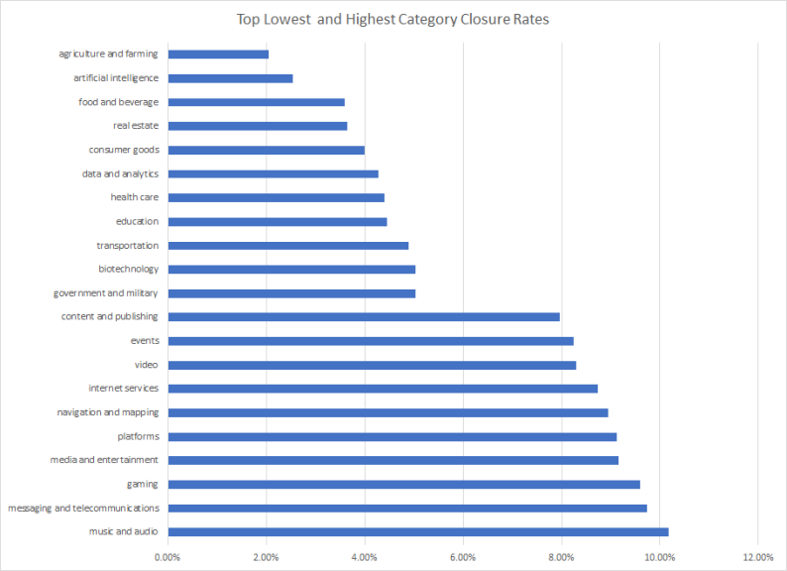
Rates of Closure for Categories of Industry
Many tech companies in top 10 highest rates of closure
Ag/farming has lowest rate of closure!
Industries that serve core needs have low rates of closure

Slide 10
International Closure Rates
Most countries were closer to together than expected
The US was the 12th highest percentage-wise, but it wasn’t that high compared to anywhere else.
US - 7.4% average closure rate (2971 out of 39,790 companies since 1990)
Germany - 6.1% average closure rate (74 out of 1198 companies since 1990)
Japan - 3.72% average closure rate (17 out of 456 companies since 1990)

Slide 11
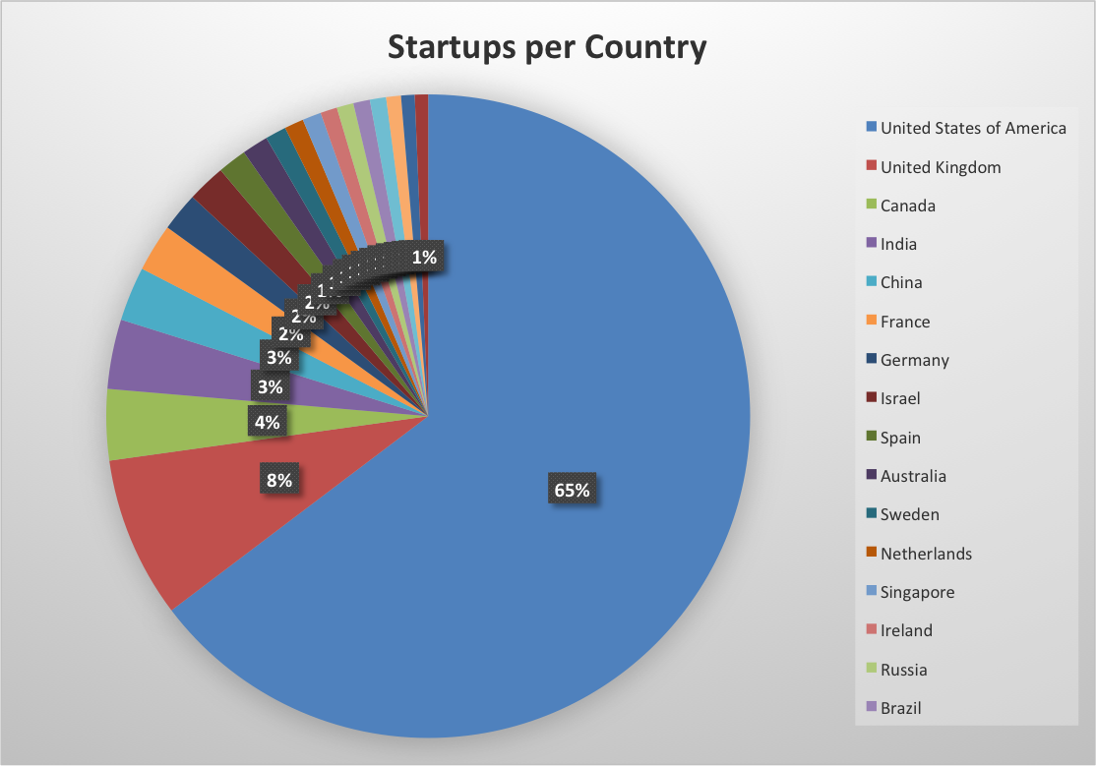
Where the US Fits
The US contains the most startups by a huge margin.
The US doesn’t appear on the top 10 average funding list.
This data led us to the conclusion that the average funding might affect whether startups succeed since the US ranked 12th on our list of average closure percentage by country.

Slide 12
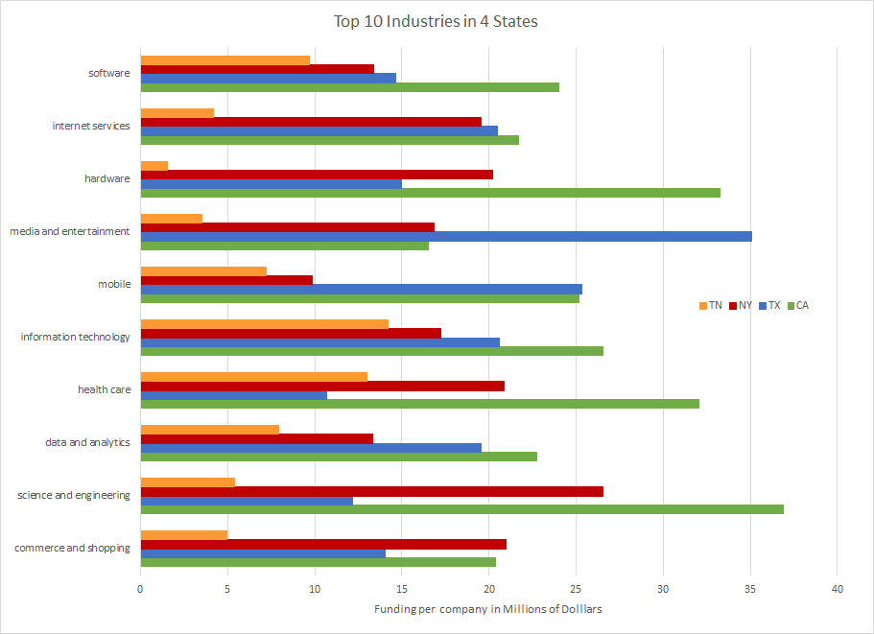
Largest Industries in USA
The most dominate industry varies by each state
The top 10 most populated industries in each state are exactly the same
IT and Software have similar funding rates compared to other industries
What does this mean the for the job market?

Slide 13
Correlation with the Stock Market?
Interested in how startup success/failure correlated with stock market in US
Computed rate of closure and average funding per year of founding for just companies in the US
DOW Jones and S&P 500 indices used in comparison
Notes:
This is where we pivot from what influences startups, to interesting side notes about correlation between stock markets in the US and funding for startups.

Slide 14
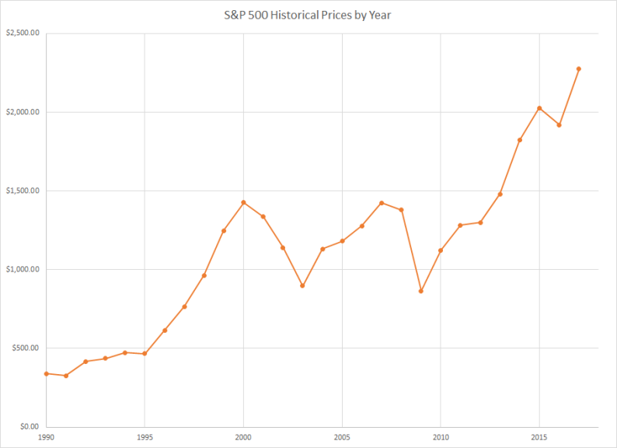
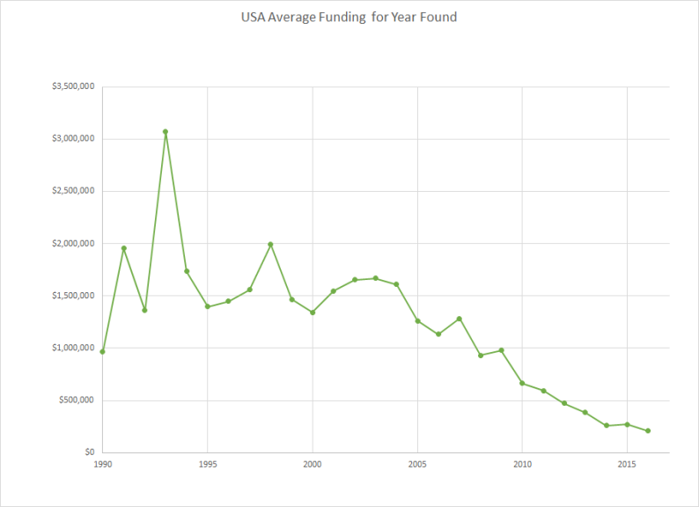
S&P 500 v.s. Average Funding for Year Founded
Dot com bubble bursts
Great Recession starts
Notes:
Talk about the correlation between funding vs stock market. Notice as average funding goes down, the stock market goes up. This could possibly imply that there’s an eventual payoff for startups that were invested in in the past.

Slide 15
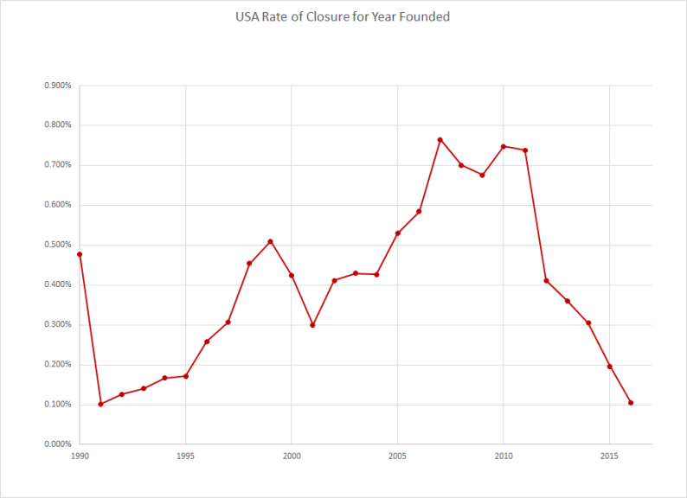
S&P 500 v.s. Rate of Closure for Year Founded
Great Recession starts
Dot com bubble bursts

Slide 16
Conclusions
Tech is not as highly-funded as anticipated
The United States is not anywhere near the top in terms of average funding
Yet many startups in USA
African countries have high levels of average funding nationally
Interesting correlation with the Great Recession
If you want to start a company, perhaps focus it on the factors essential to life

Slide 17
Challenges Faced
Determining what statistics to use
Data wrangling
Making inferences from the results

Slide 18
Further Development
Investigate rates of IPOs for companies in areas of highest average funding and lowest rates of closure
Learn more stats to do even more advanced analysis
Compare data to world events/news

